Slide 1
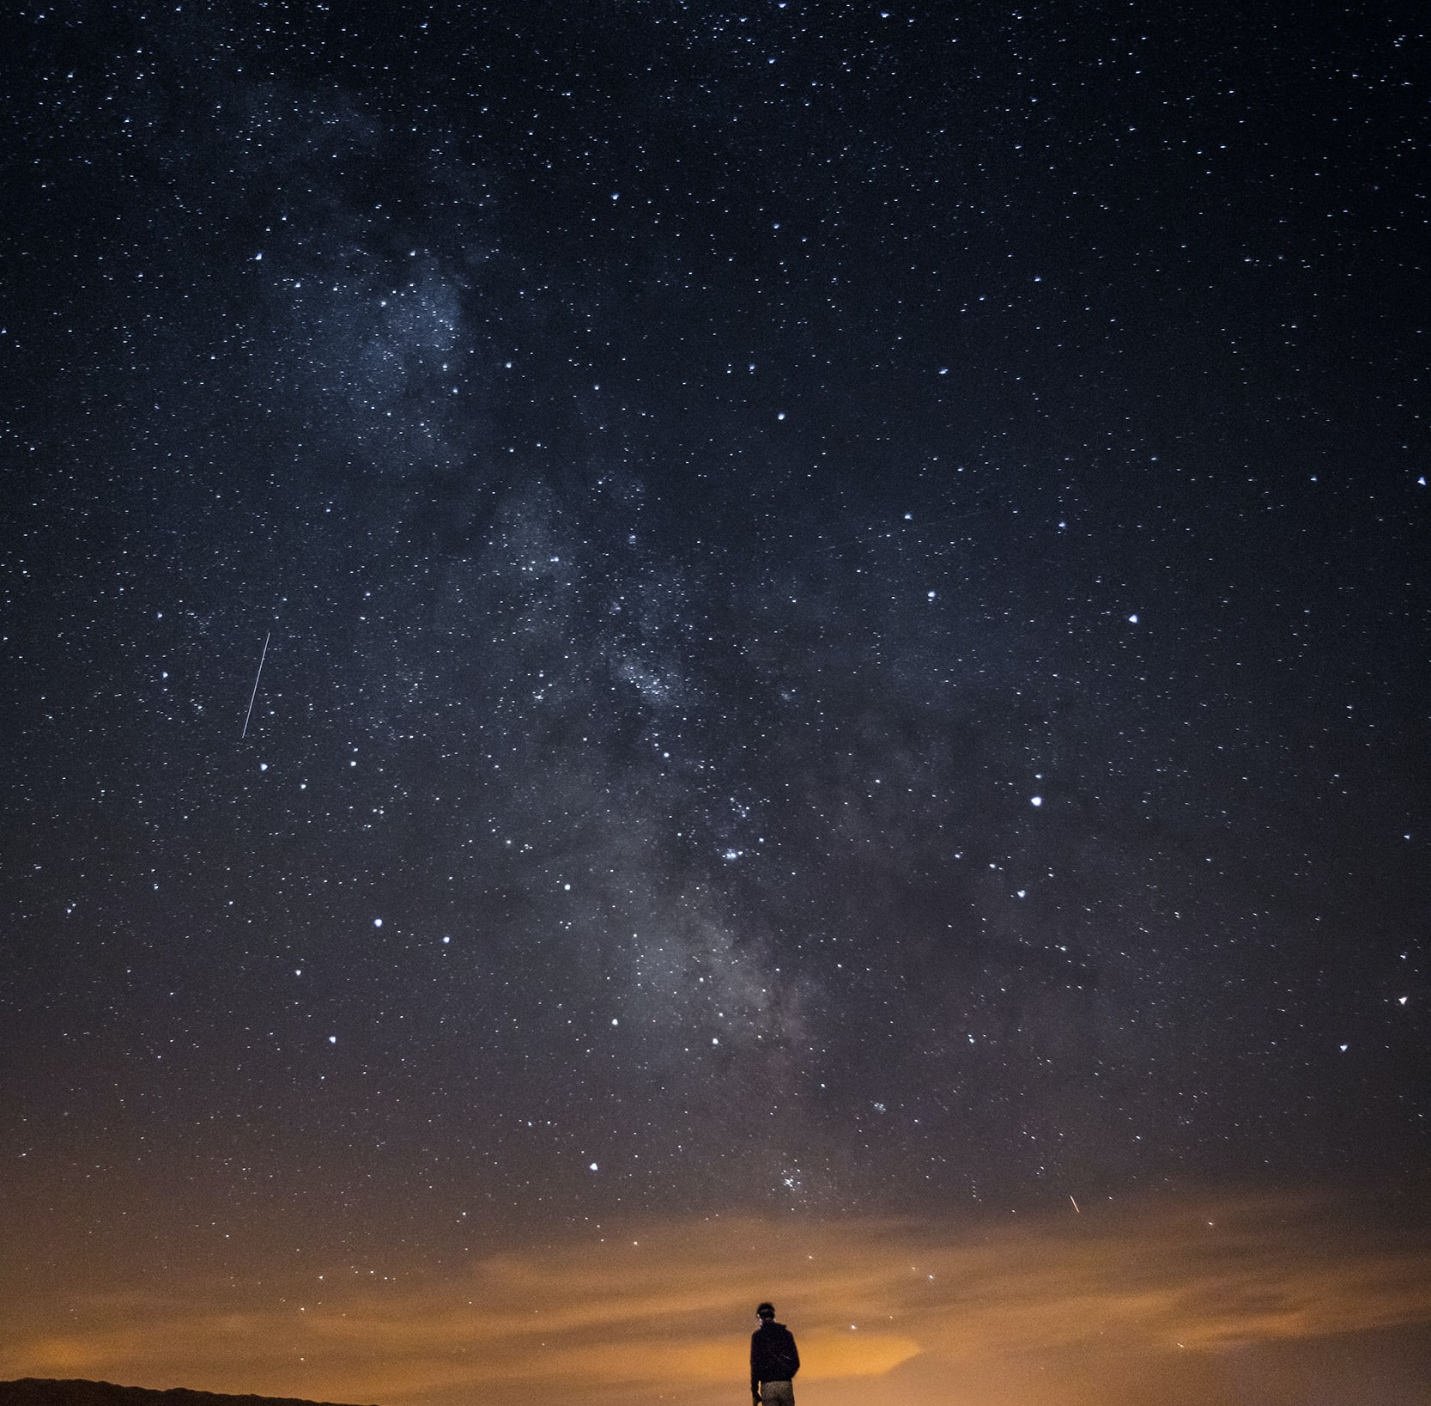
Creative Programming and Computing
Music and Acoustic Engineering
Ed uscimmo a riveder le stelle
Inferno XXXIV, 139
Gianmarco Debortoli – Federico Ceriola
a.a. 2021/2022

Slide 2
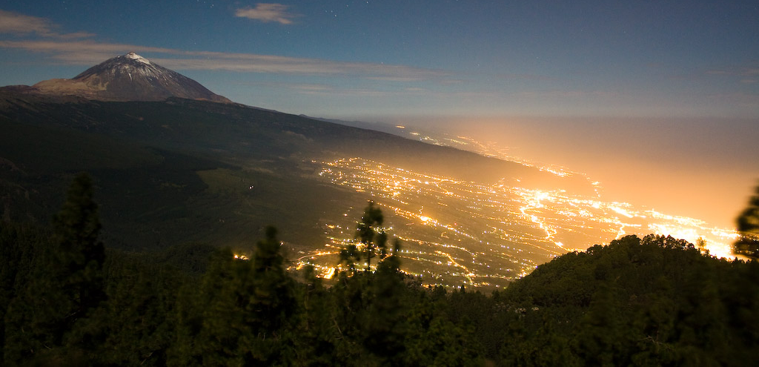
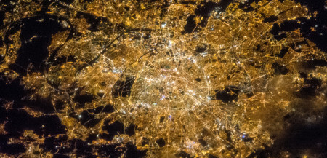
Creative Programming and Computing
Music and Acoustic Engineering
Main Concept:
Lights pollution in the dark sky:
Light Pollution unnecessarily contributes to climate change.
Light pollution kills millions of birds a year.
Artificial light at night disrupts the seasonal cycle of trees.
Relevant number of people have never seen the real sky at night (the Milky Way).
Exposure to artificial light at night puts your health at risk.
Gian Marco De Bortoli – Federico Ceriola
a.a. 2021/2022

Slide 3


Creative Programming and Computing
Music and Acoustic Engineering
Our Story:
Interactive Installation
Imagine you could switch off all the artificial lights on the planet.
You would be able to see the real natural light of the dark sky.
It would be the same experience of a child discovering the world, with equal curiosity and astonishment.
Visual and sound discovering experience
Gian Marco De Bortoli – Federico Ceriola
a.a. 2021/2022

Slide 4
Creative Programming and Computing
Music and Acoustic Engineering
Physical tools:
Software tools:
We give a special flashlight to the «child» (user), which is used to navigate onto the skies. It is a cylindrical object with a colored face.
He/she stands in front of a camera which captures the image and his/her motion.
With the use of color tracking we aim at mapping the position of the flashlight and projecting it on the screen. We use it to «unveil» the stars from the polluted sky.
The interaction with the stars sends OSC messages to Ableton in order to produce sound.
Gian Marco De Bortoli – Federico Ceriola
a.a. 2021/2022

Slide 5
Creative Programming and Computing
Music and Acoustic Engineering
The sky
Three layers
1. Pollution
An oppressive veil of smokey glare from the city lights covers the view of the stars.
The flashlight is the tool able to «clean the dirt».
3. Universe
A clear night sky with diffused colors recalling different galaxies serves as background for the picture.
2. Stars
Glowing points of different pale colors and dimensions distributed all over the screen for the user to interact with.
Gian Marco De Bortoli – Federico Ceriola
a.a. 2021/2022

Slide 6
Creative Programming and Computing
Music and Acoustic Engineering
Pointing Mechanism
The «torch» indicates a point on the screen (the red one) that is the center of a circle.
Every star that is inside the circle interact from a sounding point of view depending on:
Distance from the center
Dimensions
Brillance
Color
Gian Marco De Bortoli – Federico Ceriola
a.a. 2021/2022

Slide 7
Creative Programming and Computing
Music and Acoustic Engineering
Messages Chain
Video Interaction
Processing
OSC send
Ableton:
OSC receiver
Sound Generation
Audio Split
OUT 1-2
to the PA
OUT 3-4
SuperCollider:
OSC receiver
MIDI notes generator
OSC send
Gian Marco De Bortoli – Federico Ceriola
a.a. 2021/2022

Slide 8
Creative Programming and Computing
Music and Acoustic Engineering
Additional elements
The sun:
The sensation of time flow is introduced by the presence of the sun.
The user is in mid-interaction with the application when this entity enters the scene stealing the control away from the user’s hands and recalling the feeling of a life inside a polluted city.
An immersive experience:
The user is not just a spectator, he/she is the main character of the story.
From the camera we capture the scene and we project it onto the screen as if the separation between the physical world and the virtual world was just the same window separating the child from the city.
Gian Marco De Bortoli – Federico Ceriola
a.a. 2021/2022

Slide 9
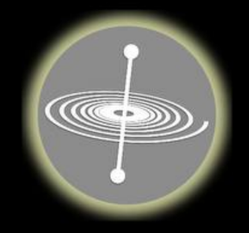

Creative Programming and Computing
Music and Acoustic Engineering
User’s interaction
Auxiliary Audio Out
OSC messages
GyrOSC
Audio signal
Video signal
Processing
Max4Live
Ableton Live
Video Out
Audio Out
Perception
Gian Marco De Bortoli – Federico Ceriola
a.a. 2021/2022

